Slide 1

Customer Shopping Behavior Analysis
3,900 purchases • 18 columns • goal: uncover spending, segments, preferences, subscriptions

Slide 2
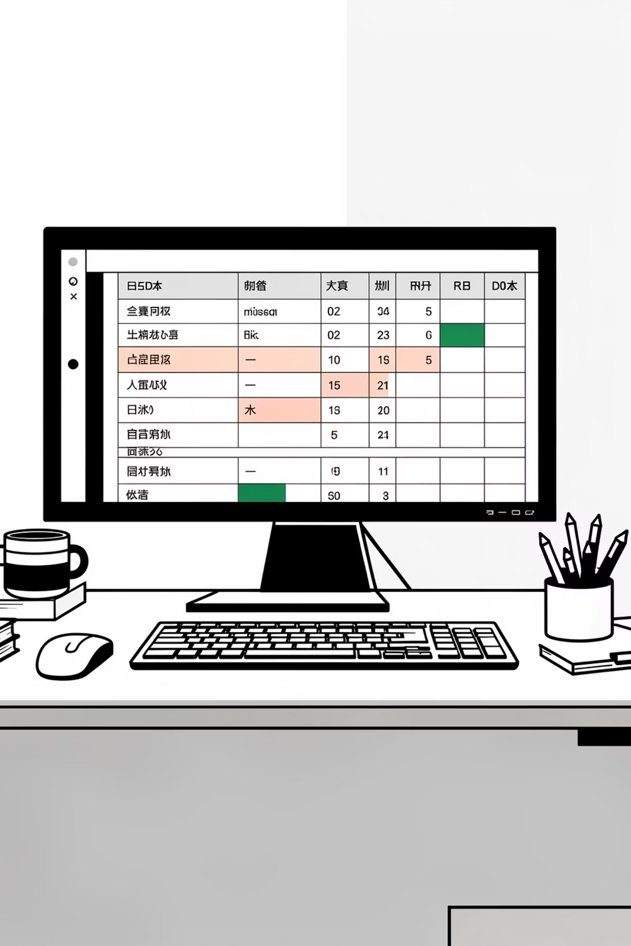
Dataset Snapshot
Rows
Columns
3,900
18
Missing
37 ratings null

Slide 3


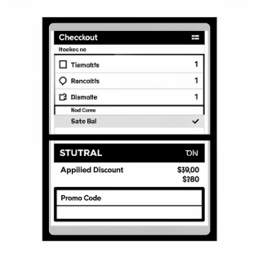
Key Features
Demographics
Purchase Details
Behavior
Age, Gender, Location, Subscription
Item, Category, Amount, Season, Size, Color
Discounts, Promo, Frequency, Reviews, Shipping

Slide 4

EDA — Python Work
Steps
Cleaning
Engineered
Load with pandas • df.info() • .describe()
Imputed ratings by category median
age_group • purchase_frequency_days
DB
Cleaned DF → PostgreSQL

Slide 5
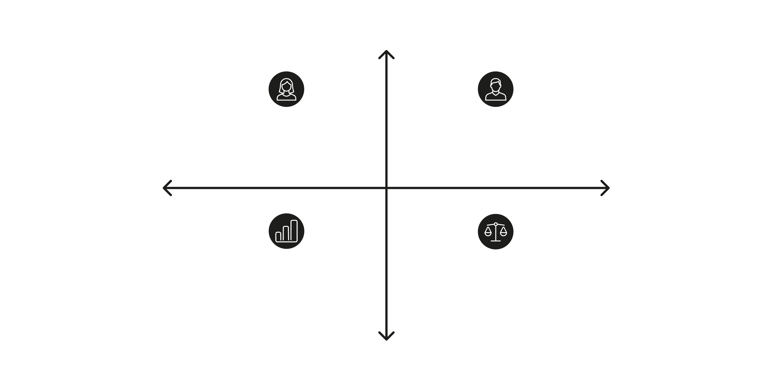

Higher Revenue
Higher Female Revenue Share — 75,191
Higher Male Revenue Share — 157,890
Revenue Balance
Gender Comparison
Combined Total — 233,081
Male >> Female Disparity
Lower Revenue
Male revenue notably higher: Male 157,890 vs Female 75,191

Slide 6

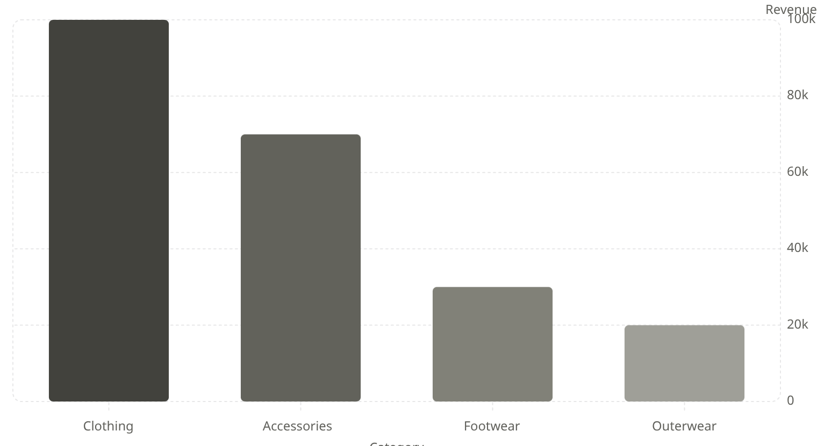
Category Performance
Clothing leads revenue and sales. Use these insights for product positioning and campaigns.

Slide 7
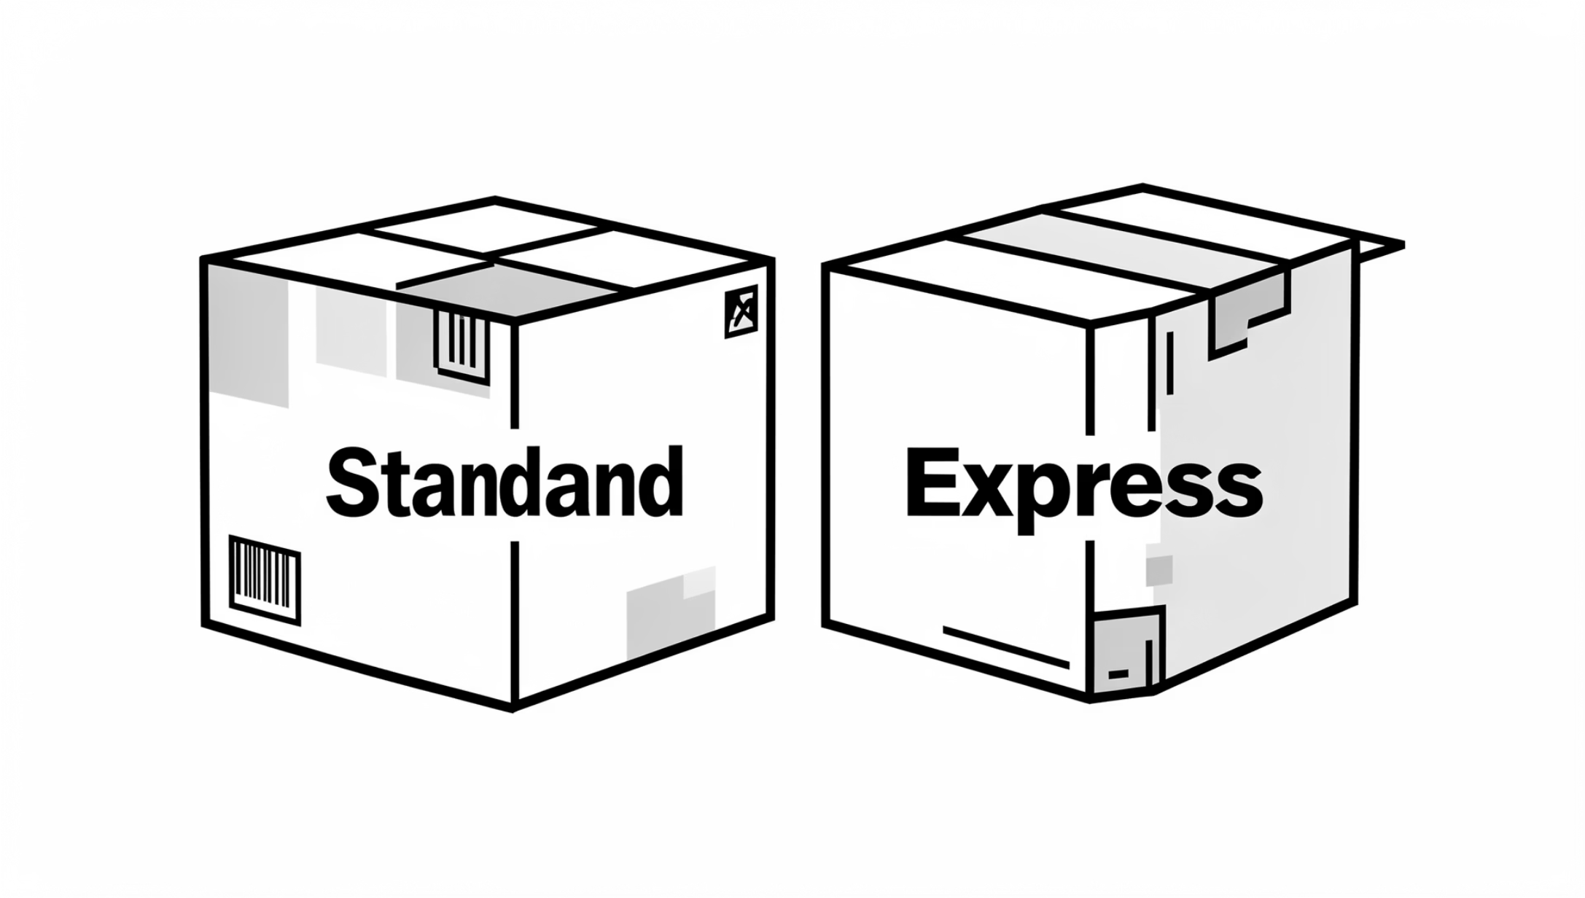
Shipping & Spend
Standard
Avg $58.46
Express
Avg $60.48
Express users slightly higher spend — target with shipping promotions.

Slide 8
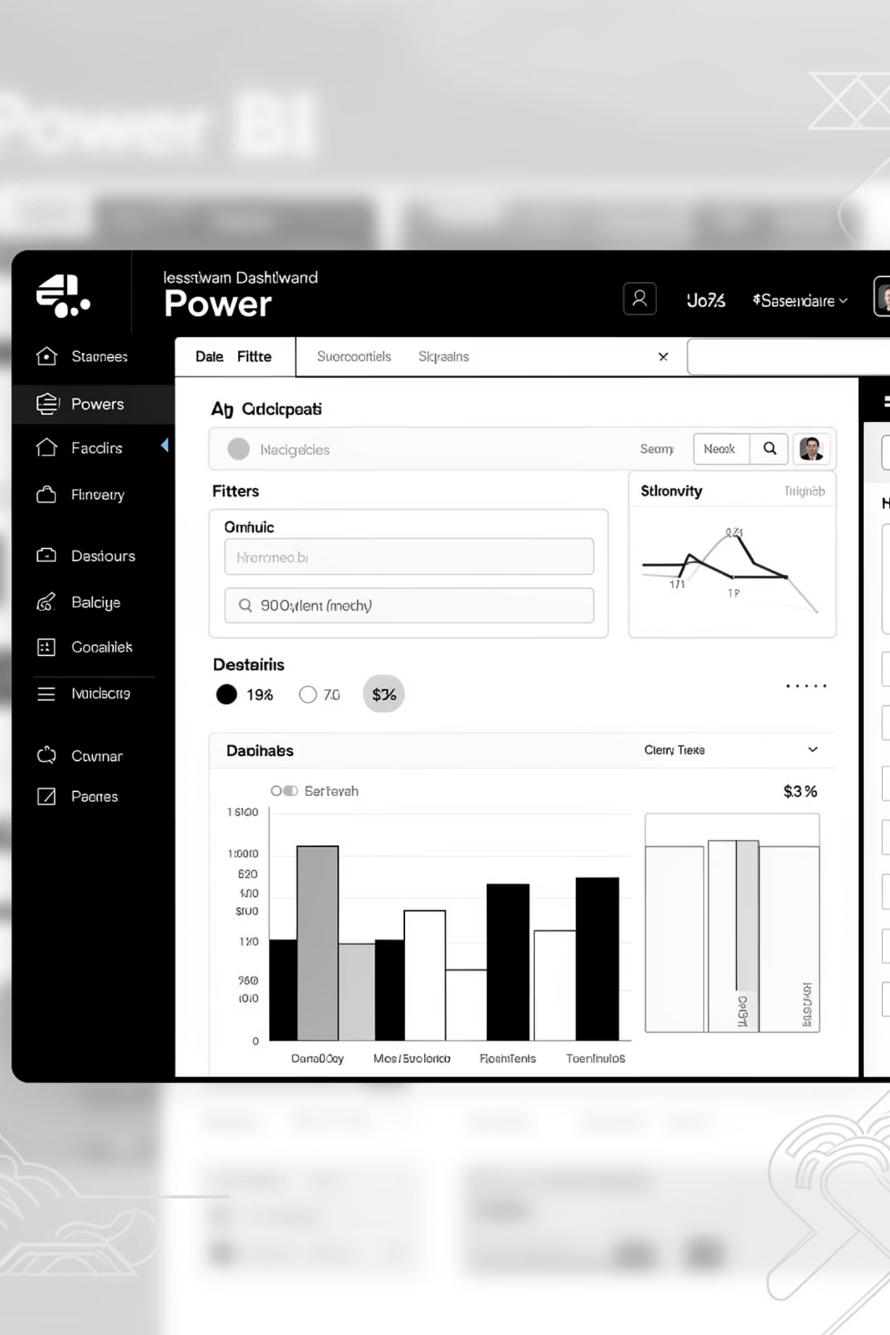
Dashboard Highlights
Customers
3.9K
Avg Purchase
$59.76
Avg Rating
3.75
Subscribers
27% Yes • 73% No

Slide 9


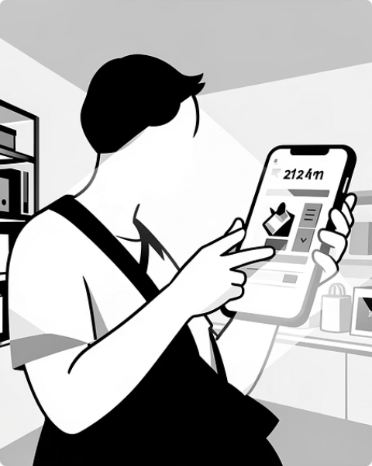
Customer Segments & Behavior
Loyal
New
Returning
3,116 customers — focus retention
83 customers — nurture onboarding
701 customers — upsell opportunities

Slide 10
Business Recommendations
Boost Subscriptions
Loyalty Programs
Review Discount Policy
Promote exclusive benefits to increase subscribers
Reward repeat buyers to grow Loyal segment
Balance sales lift with margin control
Targeted Marketing
Product Positioning
Focus on high-revenue age groups & express-shipping users
Highlight top-rated & best-selling items in campaigns

